Slide 1
P
R
O
F
I
T
I
BUY
L
O
S
S
K
SELL
SBI Stock Price Prediction
Using Time Series
Presentation by- Dhananjay Daharia ,Batch –PGDA24

Slide 2

Contents
01
Introduction
02
Problem Statement
03
Dataset and Key Findings
03
Challenges
05
Process Flow
06
Analysis and Results
07
Conclusion
08
References

Slide 3
Introduction
Stock Market
60%
Stock markets are where individual and institutional investors come together to buy and sell shares in a public venue. Nowadays these exchanges exist as electronic marketplaces.
That supply and demand help determine the price for each security or the levels at which stock market participants — investors and traders — are willing to buy or sell.
The concept behind how the stock market works is pretty simple. Operating much like an auction house, the stock market enables buyers and sellers to negotiate prices and make trades.
.
Definition of ‘Stock’
A Stock or share (also known as a company’s “equity”) is a financial instrument that represents ownership in a company
24%

Slide 4
What is Time Series Data ?
It is recorded at regular time intervals, and the order of these data points is important. Therefore, any predictive model based on time series data will have time as an independent variable. The output of a model would be the predicted value or classification at a specific time.
60%
Time series forecasting
It is used to predict future values based on previously observed values and one of the best tools for trend analysis and future prediction.
24%

Slide 5
Problem Statement
Here we have been given the historical data of SBI stocks and we need to forecast the
stock prices of the near future
P
R
O
F
I
T
I
L
O
S
S
K

Slide 6
Dataset
Date of transactions.
Change%
Date
%change in Stock from previous.
Prices of stocks traded.
Price
Volume
Volume of traded stocks
Highest price of stock at that date
High
Low
Lowest price stocks at that date
Opening price
Open
BUY
SELL

Slide 7
Challenges
Trend Component
Long-run increase or decrease over time (overall upward or downward movement
Seasonal Component
Short-term regular wave-like patterns observed monthly, quarterly or yearly
Cyclical Component
Long-term wave-like patterns , occurs regularly but vary in length and measured peak to peak or trough to trough
Irregular Component
Unpredictable, random, “residual” fluctuations

Slide 8
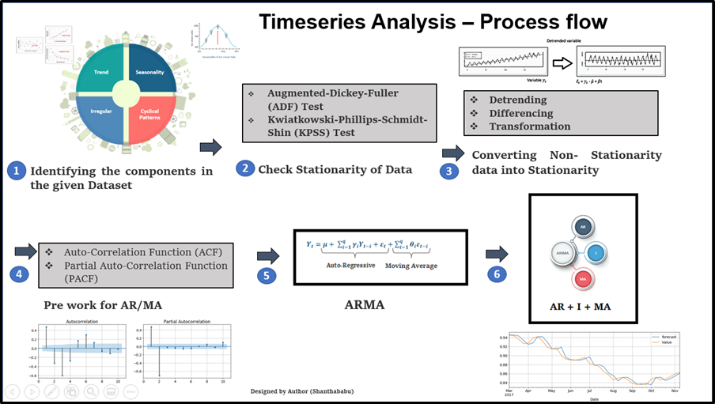
Process Flow

Slide 9
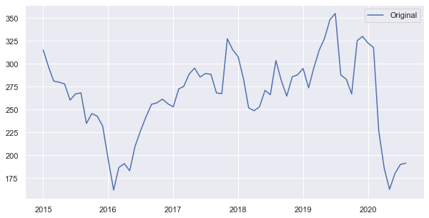
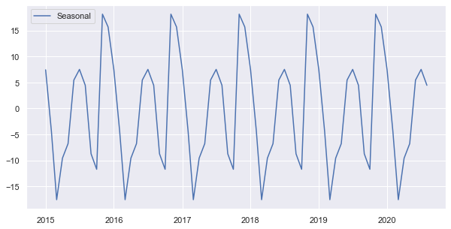
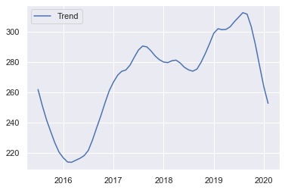
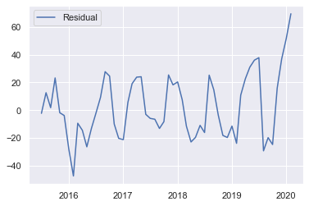
Analysis
P
R
O
F
I
T
I
L
O
S
S
K

Slide 10
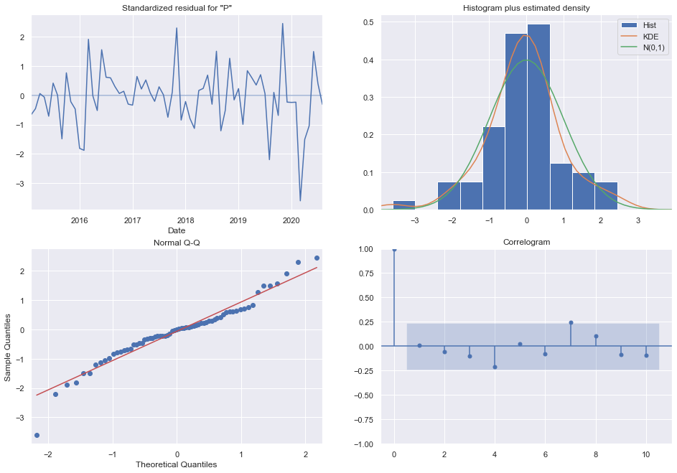
Model diagnostics to check any unusual behavior
1. If the model is correctly specified and the parameter estimates are reasonably close to the true values, then the residuals should have nearly the properties of white noise.
2. Plots can be used to better understand the distribution of errors beyond summary statistics. We would expect the forecast errors to be normally distributed around a zero mean.
3. The Q-Q plot can be used to quickly check the normality of the distribution of residual errors.
4. Finally, visualizing the autocorrelation for the residual errors. The x-axis shows the lag and the y-axis shows the correlation between an observation and the lag variable, where correlation values are between -1 and 1 for negative and positive correlations respectively. We would not expect there to be any correlation between the residuals. This would be shown by autocorrelation scores being below the threshold of significance (dashed and dotted horizontal lines on the plot).
The model diagnostics indicates that the model residuals are near normally distributed

Slide 11
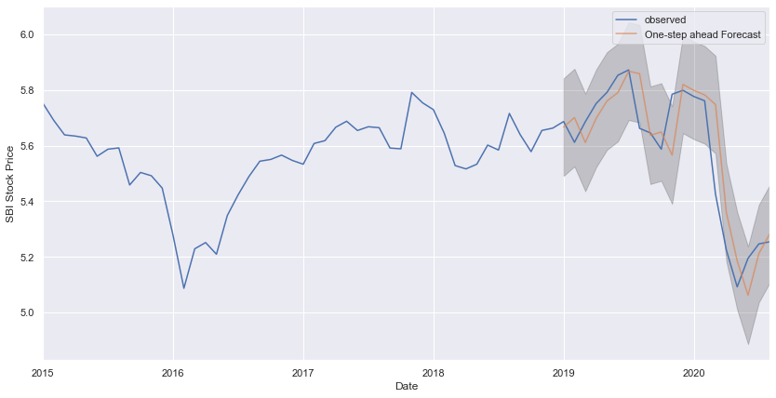
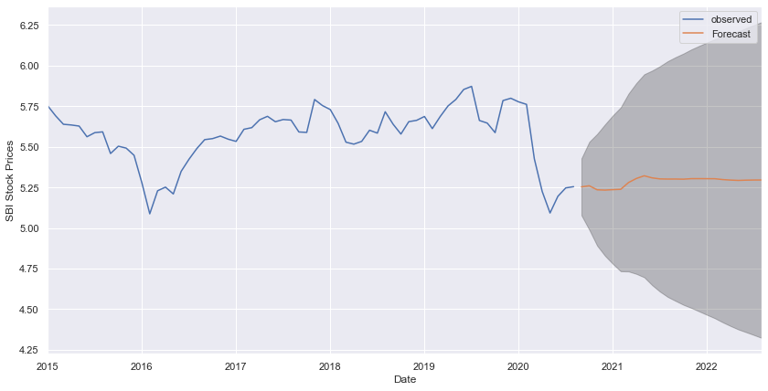
Results
Forecast from 2019-01-01 to end of the data
76.92%
0.11
.
Accuracy
RMSE
02
Your Contents Here
You can simply impress your audience and add a unique zing and appeal to your Presentations.
P
R
O
F
I
T
I
L
O
S
S
K
Future forecast for next 2 years

Slide 12
Conclusion
We observe that Prices of SBI Stocks produces seasonal pattern. Early of the year is in season for Stocks investments in the SBI. The Stock Prices decreases linearly over time and again toward the end of the season and in coming years it saturates.
So from all these analysis we still cannot predict the uncertainties in the data perfectly that’s why we need to do the analysis with the help of deep learning model and continue to get more accuracy
P
R
O
F
I
T
I
L
O
S
S
K

Slide 13
References
www.analyticsvidhya.com/blog/2021/10/a-comprehensive-guide-to-time-series-analysis/
Data Science Blogathon - 13 (analyticsvidhya.com)
Taxonomy of Time Series Forecasting Problems (machinelearningmastery.com)
Time Series Analysis in Python - A Comprehensive Guide with Examples - ML+ (machinelearningplus.com)
P
R
O
F
I
T
I
L
O
S
S
K

Slide 14
Thank you
.

